Slide 1
SSENSE.com Recommendation Engine
an end-to-end data science project
by Tri Nguyen
github.com/nqtri/SSENSE-Product-Recommendation-System

Slide 2
Agenda
Introduction
Data Collection & Exploratory Data Analysis
Feature Engineering
Recommendation Engine
Web App Deployment & Demo
Business Impact Evaluations
Limitations & Next Steps
Q & A

Slide 3
INTRODUCTION

Slide 4
What & Why?
SSENSE.com
Favorite Canadian online retailer
There was no recommendation engine on the site
Difficulty to find alternative product if a chosen one is sold out
Natural Language Processing (NLP)
Term Frequency – Inverse Document Frequency (TF-IDF) concept
Topic Modeling Techniques
Full Data Science Development Pipeline
Real life data
A model should not simply stay in Jupyter Notebook
Notes:
Based in Montreal
Whole data science pipeline from data collection to end user

Slide 5
Use Cases
A wish-listed product is sold out
Problem
Users redirected to homepage when the sold-out product was clicked on
Solution
An engine that can redirect to page compiled of similar products
Products from other overseas retailers (Farfetch, Mr. Porter, etc.)
Problem
Not based in Canada, buyers are subject to heavy tax and duties
Solution
An engine that can take an offsite product’s descriptions and recommend similar products available on SSENSE.com
Notes:
Homepage, back to square one

Slide 6
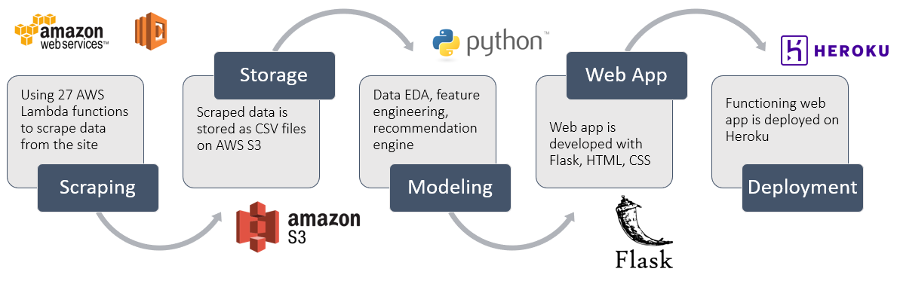
Development Process

Slide 7
DATA COLLECTION & EDA

Slide 8
Data Collection
The process has 2 stages
Getting product URLs
Looping through HTML script of each product category page to extract the JSON objects containing the URLs
Split into 4 categories (tops, bottoms, footwear, accessories) with 4 separate AWS Lambda functions
Getting product details (brands, names, description, prices, sizes, etc.)
Accessing each product URLs to obtain products’ detail from their JSON objects
Due to max runtime limit of 15 mins, 23 AWS Lambda functions were used, each handled approx. 1,500 products
Extracted information is processed, combined, and stored on AWS S3

Slide 9
Exploratory Data Analysis
88
Categories
28,992
Products
432
Brands
19+
Countries of Origin

Slide 10
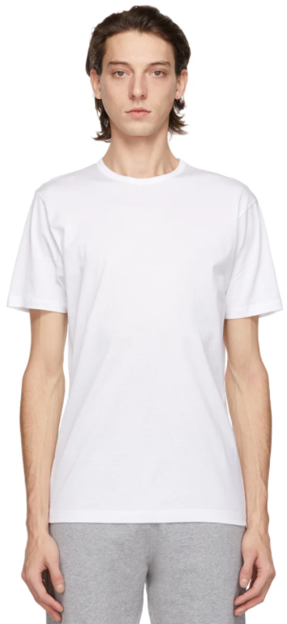
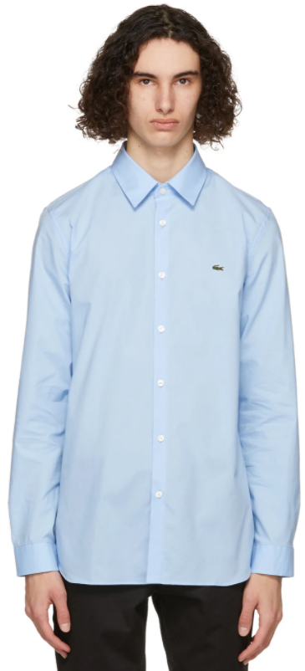
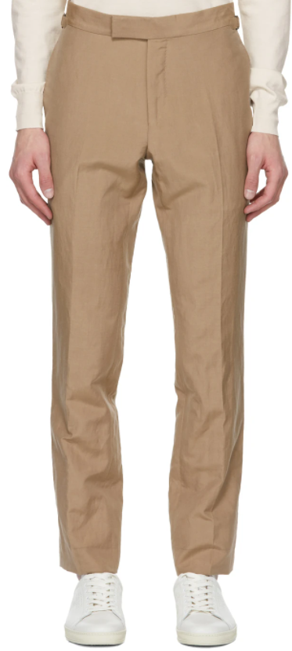
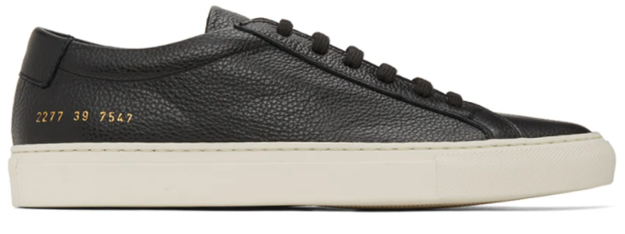
Top Product Categories
Low Top Sneakers
Shirts
Trousers
T-shirt

Slide 11




Most Popular Brands

Slide 12
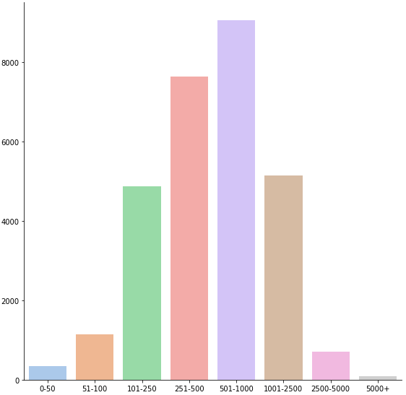
Prices
Price Range Histogram
# of Items
Price Range

Slide 13
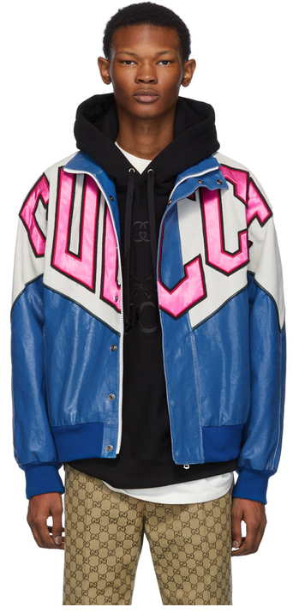
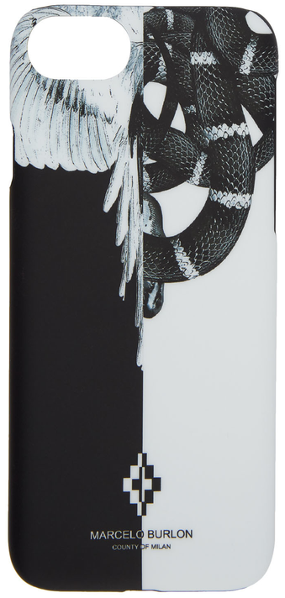
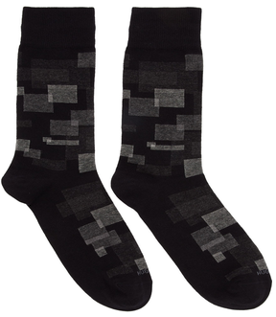
Max Price
$9,450
Min Price
$9
Most Discount
70%
Gucci Blue Banana Bomber Jacket
Hugo Boss Black RS Square Socks
Marcelo Burlon iPhone 8 Case

Slide 14
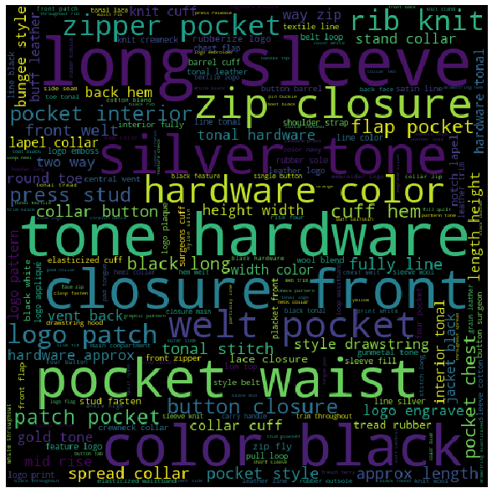
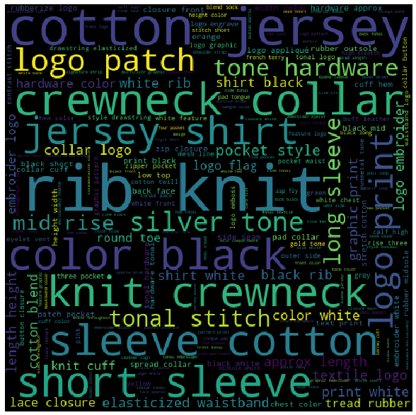
Top 5,000 by Sale Price
Bottom 5,000 by Sale Price
Notes:
You can almost tell the difference, the more expensive items carry words like hardware, silver, etc. Focuses on things that make the product stand out
The cheaper products are more minimal and basic like crewneck or cotton jersey

Slide 15
Feature Engineering

Slide 16
Easy Features
Features like ‘categories’, ‘brands’, ‘origins’, and ‘sizes’ are already well classified
Some brands such as collaborations require more attention
Words describing colors (i.e. red, yellow, offwhite)
Words describing materials (i.e. cotton, wool, leather)
Encoded with Multi-Label Binarizer
Notes:
- SSENSE treat collaboration as one but I want to split that. For example, Adidas x Pharrell Williams collaborated and by splitting, the product belongs to both Adidas and Pharrell

Slide 17
Easy Features - Multi-Label Binarizer
Item | Sub-category
a | Heavy coat
b | Rain coat
c | Jacket
Item | ‘heavy’ | ‘rain’ | ‘coat’ | ‘jacket’
a | 1 | 0 | 1 | 0
b | 0 | 1 | 1 | 0
c | 0 | 0 | 0 | 1
MultiLabelBinarizer()
Notes:
- Multi-label binarizer transforms each text column into bag of words. You can see here for example, item A is heavy coat under subcategory so under heavy and coat, it has a value of 1 while 0 for the rest.

Slide 18
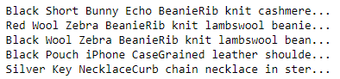
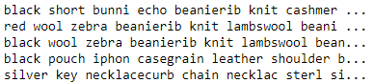
‘name’ and ‘description’ features
Pure text, requires more complicated processing
Combined and preprocessed with techniques like lemmatization and stemming
*Lemmatization & stemming: grouping together inflected form of a word (i.e. adjustable -> adjust, better -> good)

Slide 19
Topic Modelling (50 Topics Limit)
Non-Negative Matrix Factorization (Linear-algebra model)
Preprocessed text vectorized by Term Frequency–Inverse Document Frequency (TF-IDF)
Latent Dirichlet Allocation (Probabilistic model)
Preprocessed text vectorized by Term Frequency (TF) technique
TF: # of times word t appears in an item’s description / Total # of words in an item’s description
IDF: Total # of items / # of items with word t in it
Notes:
IDF what it tries to achieve is lowering the weights for very common words like the, a, an, etc.

Slide 20
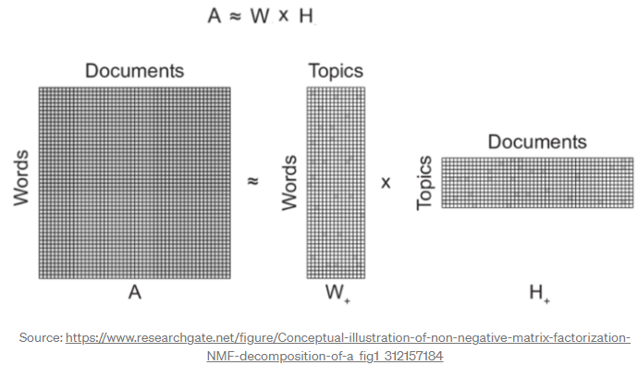
Non-Negative Matrix Factorization (NMF)
Used to identify latent structure in feature data represented as a non-negative matrix
Notes:
Matrix decomposition: A is factorized into (usually) two matrices W and H, with the property that all three matrices have no negative elements
We want to retain matrix H which contains the documents and the weighting of each topic it could belong too

Slide 21
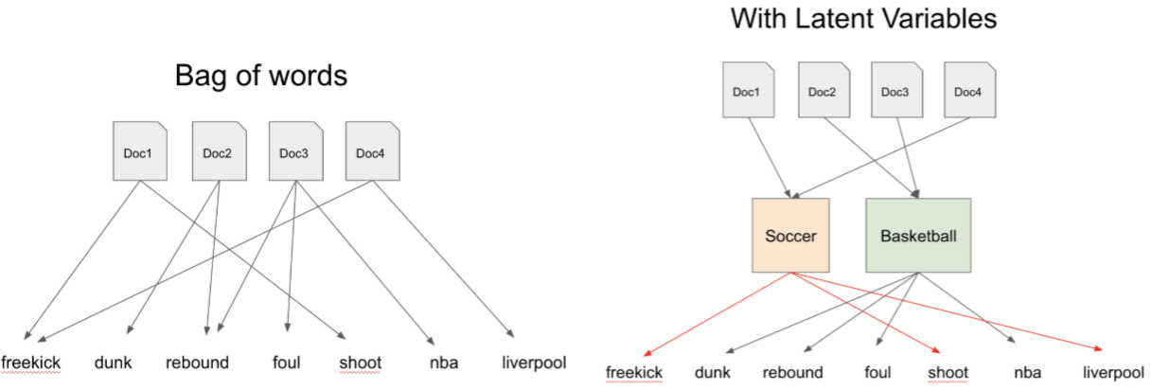
Latent Dirichlet Allocation (LDA)
An item is a probability distribution of clothing topics P(topic | item), and every topic is a probability distribution of words in product names and descriptions P(word | topic)
Source: towardsdatascience.com/dimensionality-reduction-with-latent-dirichlet-allocation-8d73c586738c
Notes:
- The example below has Doc1 and Doc4 points a lot to freekick, shoot, Liverpool while Doc2 and Doc3 point to dunk, rebound, foul, and nba. LDA can cluster Doc1 and Doc4 into topics we can classify as soccer and Doc2 and Doc3 into topic we classify as basketball.

Slide 22
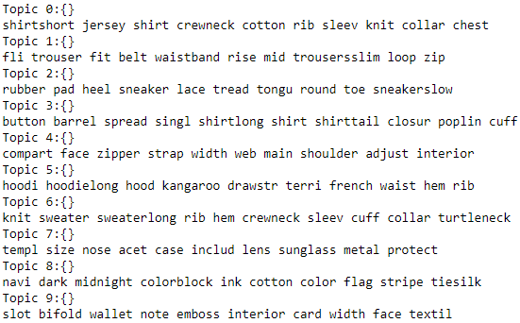
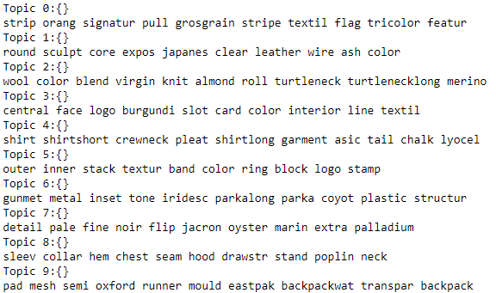
Non-Negative Matrix Factorization
Latent Dirichlet Allocation
Notes:
Here are the first 10 topics generated by both methods. I chose to proceed with NMF because the topics are more intuitive and I can show you why

Slide 23
Topics Generation Demo
''' burgundy wool crew neck panelled jumper from E. Tautz featuring a ribbed crew neck, long sleeves, elasticated cuffs, a panelled colour block design and a relaxed fit. '''
Sample Text 1
Non-Negative Matrix Factorization
Latent Dirichlet Allocation
['neck’, 'mock’, 'cardigan’, 'cardiganlong’, 'tank’, 'knit’, 'collar’, 'funnel’, 'rib’, 'topsleeveless']
['logo’, 'collar’, 'heel’, 'toe’, 'color’, 'cotton’, 'knit’, 'jersey’, 'sole’, 'rib']
Notes:
Here is an little demo of how these two methods work in action, here is a sample description of a wool crewneck jumper. You can certainly tell it’s knitwear from the bag of words in the topic NMF put this item is but not so much for LDA.

Slide 24
Topics Generation Demo
''' Rectangular metal-frame sunglasses in gold-tone. Transparent rubber nose pads. Green ZEISS© lenses with 100% UVA/UVB protection. Logo etched at temples. Tortoiseshell acetate temple tips in tones of brown. Size: 143.20 140. Supplier color: Gold/Green '''
Sample Text 2
Non-Negative Matrix Factorization
Latent Dirichlet Allocation
['templ’, 'size’, 'nose’, 'acet’, 'case’, 'includ’, 'lens’, 'sunglass’, 'metal’, 'protect']
['slip’, 'includ’, 'logo’, 'templ’, 'size’, 'pad’, 'case’, 'color’, 'nose’, 'acet']
Notes:
Here’s another one, sunglasses. Again the topic is also sunglasses for NMF from the bag of words while it’s harder to see with topic generated by LDA.

Slide 25
Recommendation Engine

Slide 26
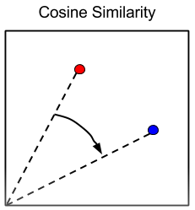
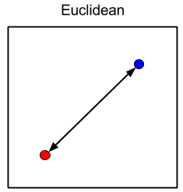
Similarity Metrics
Content-based recommendation engine
2 metrics are employed
Cosine Similarity
Calculate the cosine of the angle between two product vectors
Euclidean Distance
Calculate distance between two points on the feature plane
Notes:
Content based engine works with the similarty between items
Ideally, if items are similar, their cosine and distance is small.
Here I choose to use a weighted average approach of these two.

Slide 27
Similarity Matrix & Ranking
Item | Paul Smith Gray T-shirt | Fred Perry Gray Polo | Lacoste Pique Polo | Levi’s Denim Jacket
Paul Smith Gray Polo | 0 | 0.2 | 0.4 | 0.9
Fred Perry Gray Polo | 0.2 | 0 | 0.3 | 1
Lacoste Pique Polo | 0.4 | 0.3 | 0 | 0.8
Levi’s Denim Jacket | 0.9 | 1 | 0.8 | 0
Paul Smith Gray T-shirt
Rank | Similar Item
1 | Fred Perry Gray Polo
2 | Lacoste Pique Polo
3 | Levi’s Denim Jacket
Notes:
After the metrics are calculated using scikitlearn package, it would return the a diagonal matrix of similarity score between items. The diagonal is zero because an item is most similar to itself.
You can see that for Paul Smith Gray T-shirt, a Fred Perry Gray Polo is very similar (both are British designers, with color gray) while a levis denim jacket will have a much higher score.
For a chosen item, it would return the ascending ranking with the first item the most similar.
So here, the system will likely recommend Fred Perry Gray Polo for a Paul Smith Gray T-shirt.

Slide 28
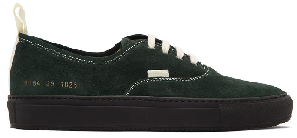
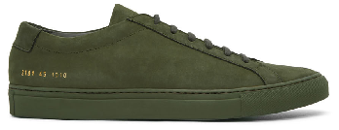
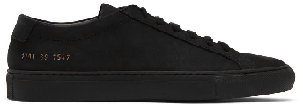
Scenario 1: Existing SSENSE Product
INPUT
Brand: Common Projects
Name: SSENSE Exclusive Green Suede Achilles Sneakers
Description: Lop-top suede sneakers in green. Round toe. Tonal lace-up closure. Padded tongue and collar. Signature series number stamped in gold-tone at sides. Tonal treaded rubber sole.
Color: Olive
Origin: Italy
Composition: Upper: leather. Sole: rubber
Full Price: 592
Sale Price: 345
Remaining Sizes: 39,40, 41, 42, 43, 44, 46, 47
OUTPUT 1
Brand: Common Projects
Name: SSENSE Exclusive Black Suede Achilles Sneakers
Description: Low-top suede sneakers in black. Round toe. Tonal lace-up closure. Padded tongue. Signature series number stamp in gold-tone at outer side. Tonal treaded rubber sole.
Color: Black
Origin: Italy
Composition: Upper: leather. Sole: rubber
Full Price: 592
Sale Price: 418
Remaining Sizes: 39,40, 41, 42, 43, 44, 45, 46, 47
OUTPUT 2
Brand: Common Projects
Name: Green Four Hole Low Sneakers
Description: Low-top suede sneakers in green. Round toe. Lace-up closure in white. Pull-loop in white at heel collar and vamp. Series number stamp in gold-tone at outer side. Leather lining in off-white. Treaded rubber sole in black. Tonal hardware.
Color: Green
Origin: Italy
Composition: Upper: leather. Sole: rubber
Full Price: 600
Sale Price: 288
Remaining Sizes: 39,40, 41, 42, 43, 44, 45, 46
Notes:
So here we entered an SKU for a common projects sneakers with the following details, and we can see that it returns both items from Common Projects, the first one is the exact same style but different color, the second one is slightly different tyle but similar in color. All have similar price point and sizes.

Slide 29
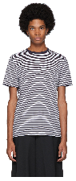
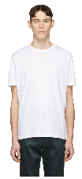
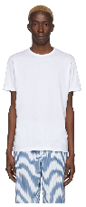
Scenario 1: Existing SSENSE Product
INPUT
Brand: Sunspel
Name: White & Navy English Stripe T-Shirt
Description: Short sleeve cotton jersey t-shirt striped in white and navy. Rib knit crewneck collar in navy.
Color: White /Navy
Origin: United Kingdom
Composition: 100% cotton
Full Price: 135
Sale Price: 69
Remaining Sizes: XS, S, XL, XXL
OUTPUT 1
Brand: Sunspel
Name: White Classic T-Shirt
Description: Short sleeve cotton jersey t-shirt in white. Rib knit crewneck collar. Tonal stitching.
Color: White
Origin: United Kingdom
Composition: 100% cotton
Full Price: 115
Sale Price: 61
Remaining Sizes: S, XXL
OUTPUT 2
Brand: Sunspel
Name: White Cotton Classic T-Shirt
Description: Short sleeve cotton jersey t-shirt in white. Crewneck collar.
Color: White
Origin: United Kingdom
Composition: 100% cotton
Full Price: 100
Sale Price: 100
Remaining Sizes: XS, S, M, L, XL
Notes:
So here, we would enter the SKU number for a t-shirt, in this case it’s from Sunspel, and the system returns two similar tshirt from Sunspel

Slide 30

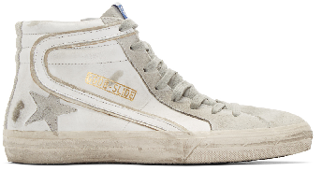
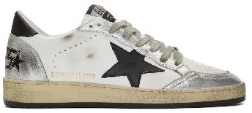
Scenario 2: Product from Other Sites
OUTPUT 1
Brand: Golden Goose
Name: White Slide Sneakers
Description: High-top panelled buffed leather and suede sneakers in white and grey. Smudging and distressing throughout. Lace-up closure in grey. Logo flag at tongue. Gold-tone logo stamp, stripe appliqué, and signature star appliqué at outer side. Zip closure at inner.
Color: White leather
Origin: Italy
Composition: Upper: leather. Sole: rubber
Full Price: 720
Sale Price: 547
Remaining Sizes: 42
OUTPUT 2
Brand: Golden Goose
Name: White & Silver Ball Star Sneakers
Description: Handcrafted low-top buffed leather sneakers in white and metallic silver-tone. Distressing, smudging, and perforated detailing throughout. Round toe. Lace-up closure in grey. Textile logo appliqué at white padded ripstop tongue. Padded collar. Signature star appliqué in black at outer side. Heel tab in black. Logo graphic embossed in black at heel counter. Rubber midsole in off-white. Treaded rubber outsole in black.
Color: White/Silver/Black
Origin: Italy
Composition: Upper: leather. Sole: rubber.
Full Price: 640
Sale Price: 403
Remaining Sizes: 41, 42, 44, 47
TEXT INPUT
Category: Sneakers
Brand: Golden Goose
Name: Starter low-top sneakers
Description: Trying to set a new personal record in competitive athleisure? Crafted from calf leather, these white Starter low-top sneakers from Golden Goose will get you a spot at the podium in no time. Ready? Set. Go! Featuring a round top, a lace-up front fastening, a contrasting heel counter, a brand embossed tongue, a pull tab at the rear, eyelets and a signature star patch detail to the side.
Color: white, silver
Origin: Italy
Composition: Outer: Calf Leather 100% Lining: Cotton 100%, Leather 100% Sole: Rubber 100%
Full Price: 770
Sale Price: 616
Remaining Sizes: 41, 42
Notes:
The second scenario is let’s say you find something from overseas and you don’t want to pay for shipping, duties and taxes, you can try searching for a similar product from SSENSE.
So here, wer’re interested in a golden goose sneakers from farfetch and we would enter the text description of it as below into the system. Interestingly, the system returns two Golden goose sneakers of similar color, white and silver, with similar sizes and prices as well. Pretty cool eh?

Slide 31
Web Application ssense-recoengine.herokuapp.com
Notes:
Then, the model seems to works but it’s not fun for it to just sit in Jupyter Notebook so I went a head and used Flask framework with HTML to build a whole functioning web application for it and host it on Heroku.
Here is the URL if you want to check it out. But beware it might be slow and prone to crashing, I just woke it up from the cold stage.

Slide 32
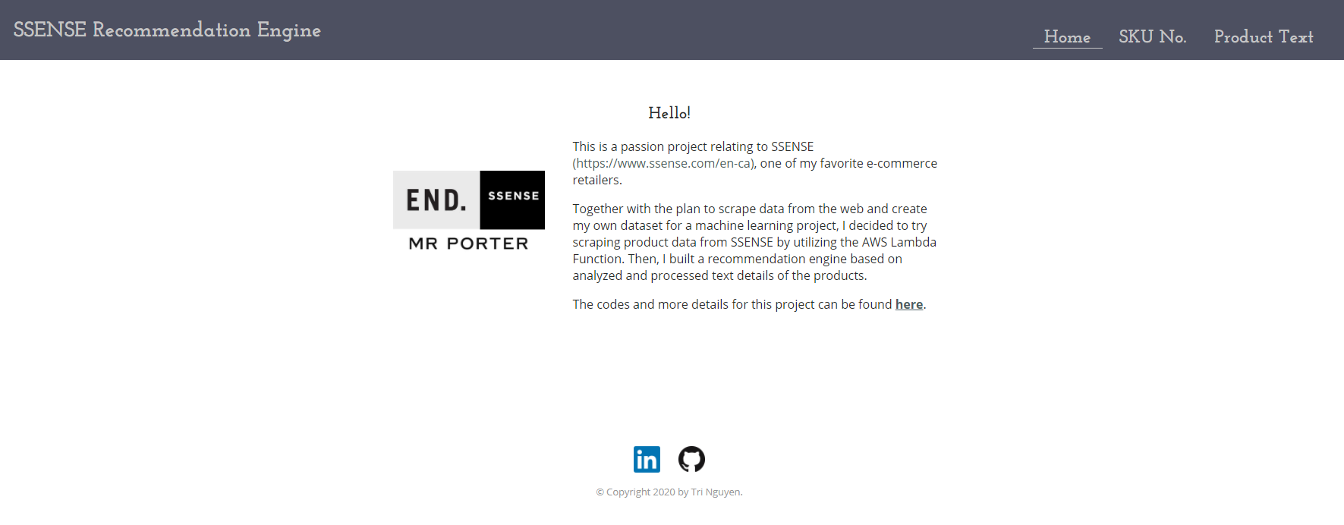
Homepage

Slide 33
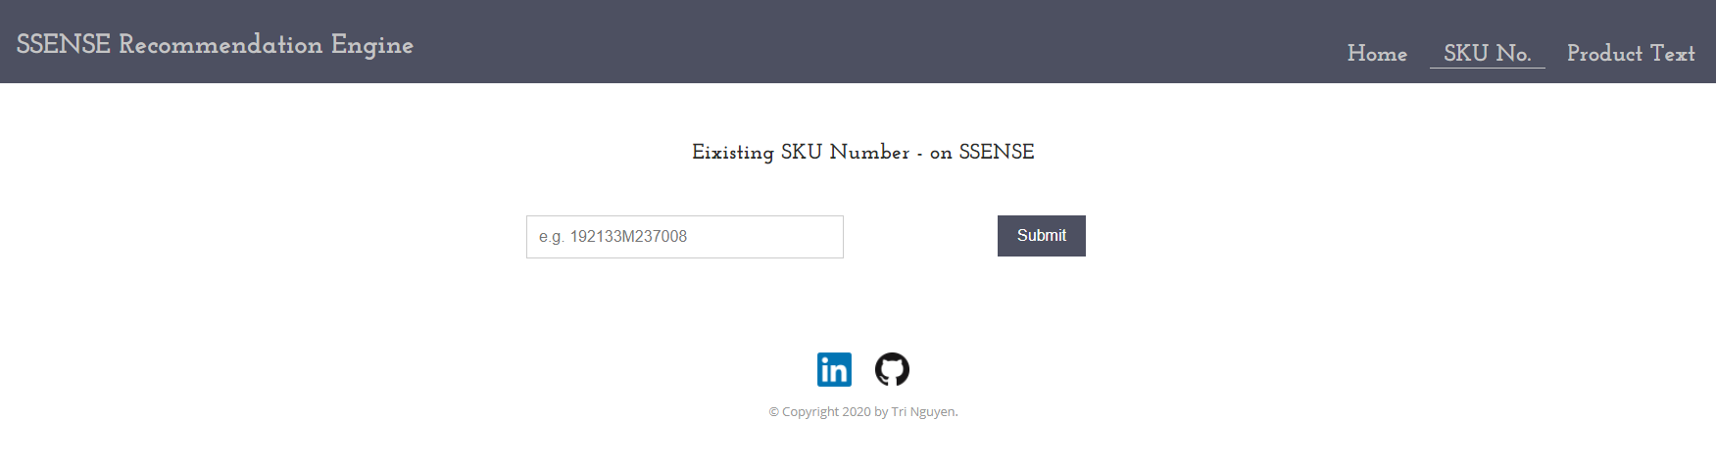
Existing Product Tab

Slide 34
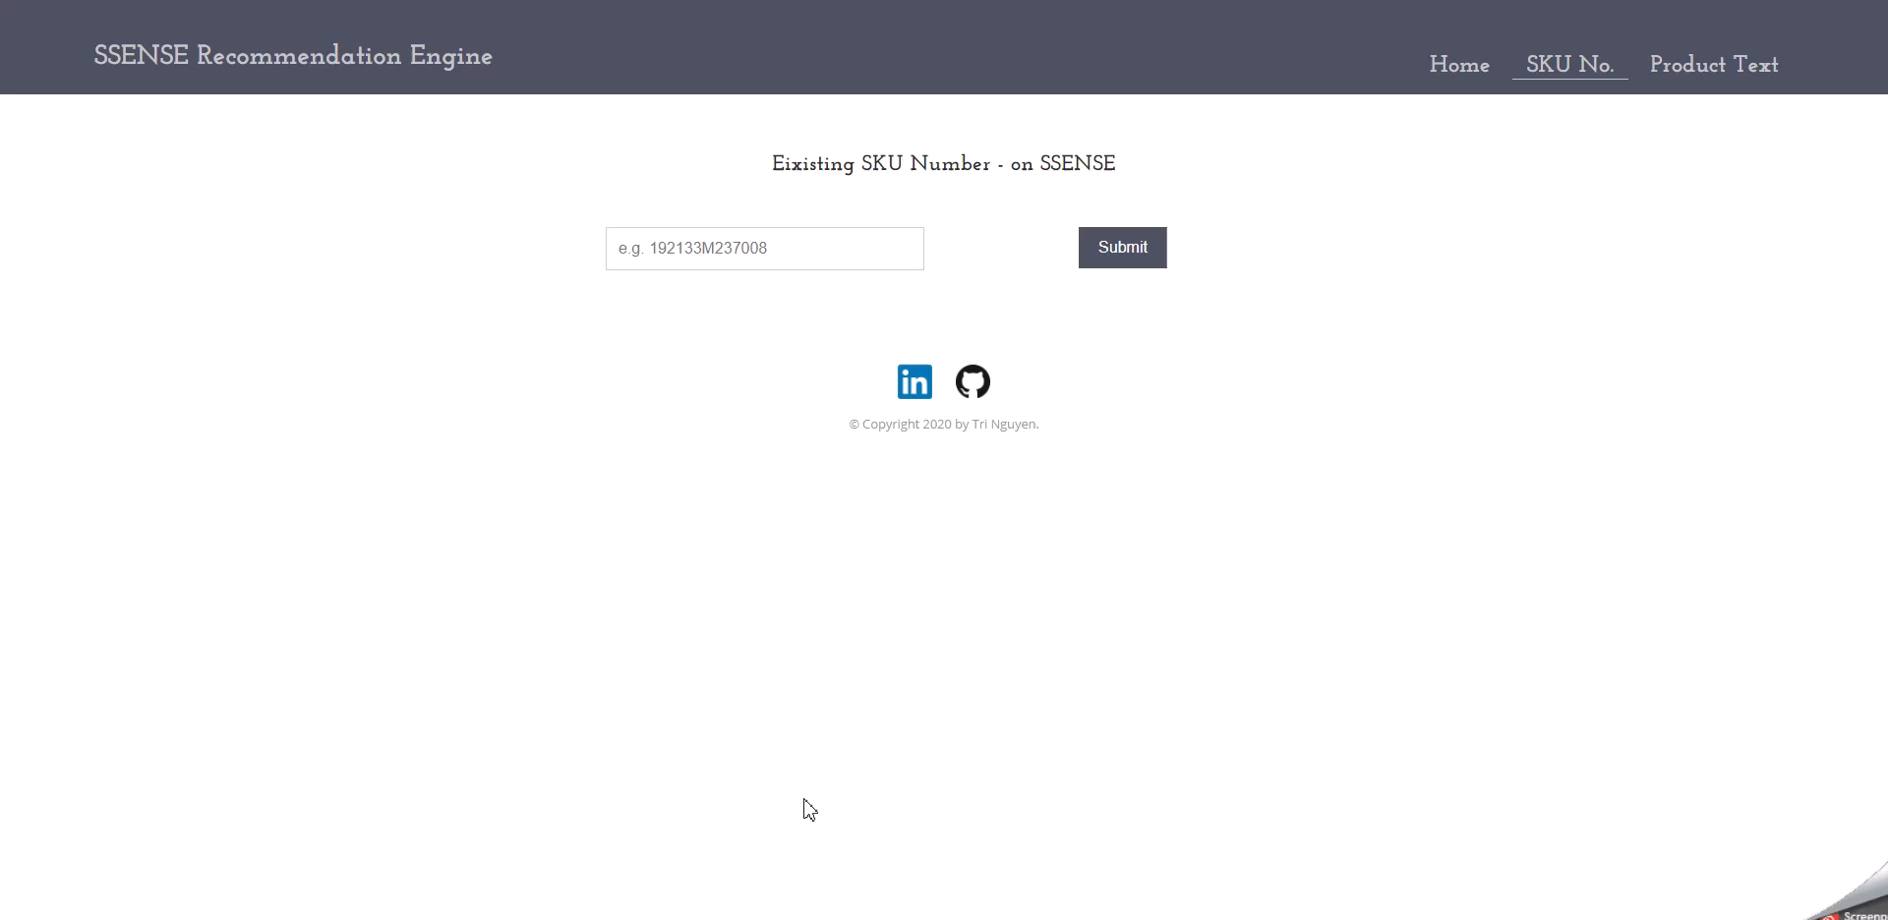
Notes:
What I entered is the SKU for a Common Projects low top sneaker and you can see that the system also recommends three other pair of common projects.

Slide 35
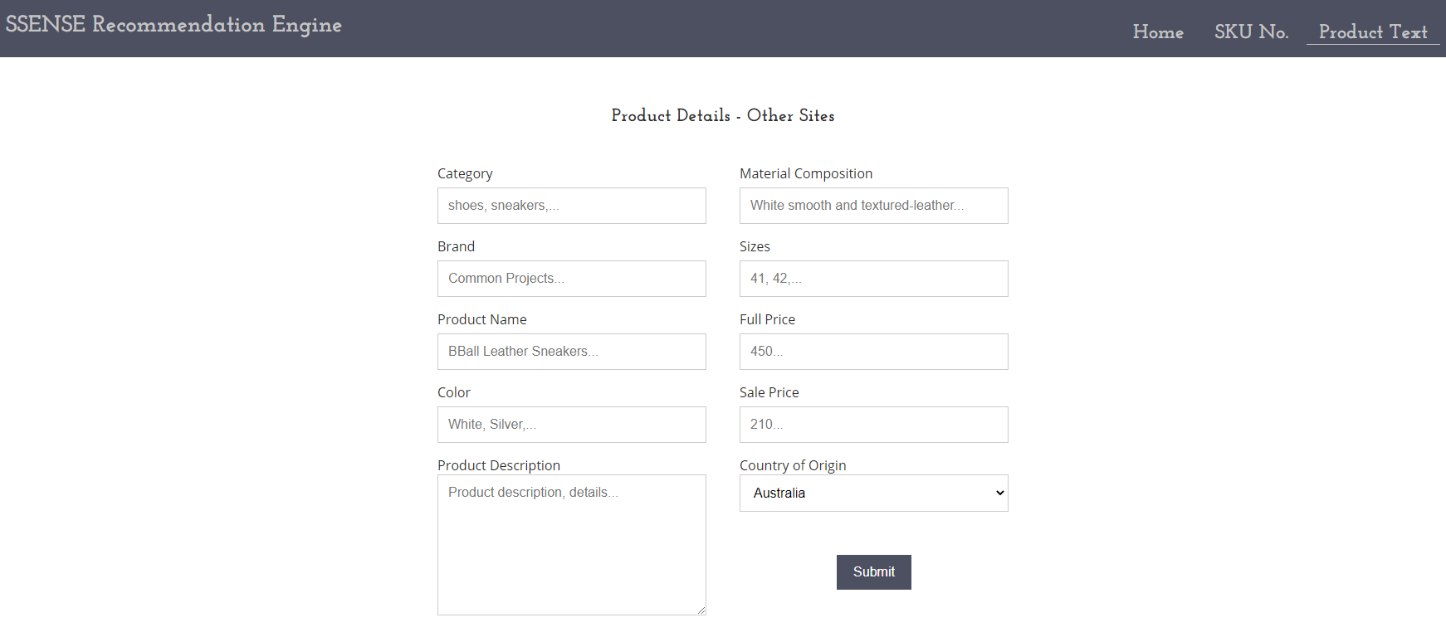
External Product Tab
Notes:
The next tab is the for products from other websites. You would basically copy and paste the details from other site into the text boxes as seen.

Slide 36
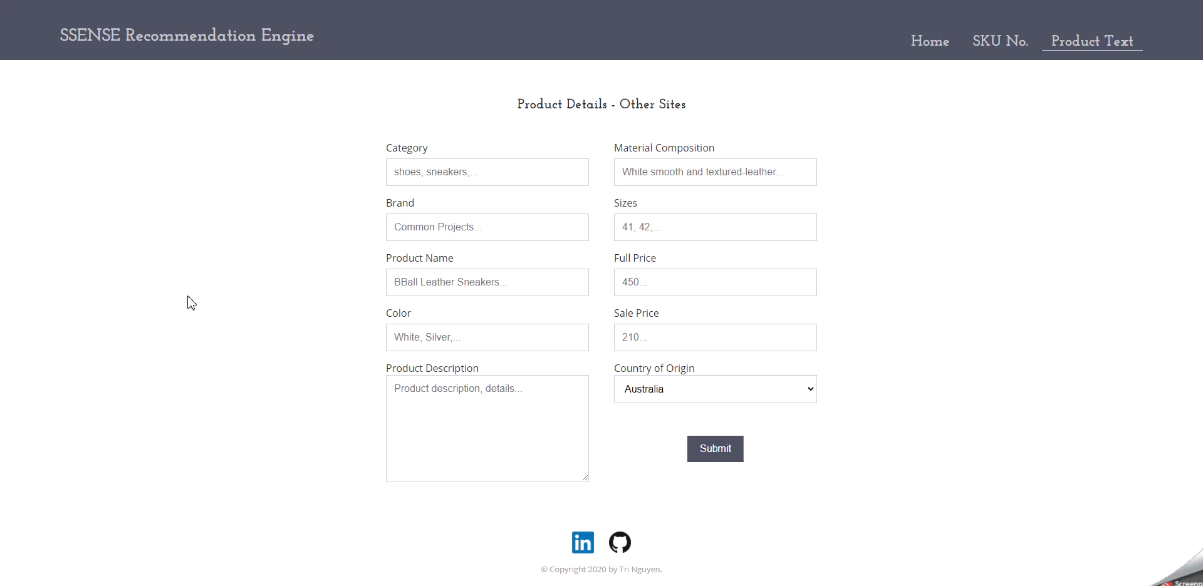
Notes:
So I’m interested in this Sunspel t-shirt from END clothing, which is a UK-based retailer.
I honestly know the origin to be Portugal because I have t-shirts from Sunspel and most of the products are either made in the UK for solid tees or Portugal for striped tees
And there you have it, the system also recommends 3 tshirts, first two are stripped some similar tone. APC made their t-shirt in Portugal, same for Paul Smith who is a British designer and the last one is from Sunspel itself.

Slide 37
Business Impact Evaluations
Notes:
So with this model, how do I know it can actually make an impact? What is the commercial value it brings?

Slide 38
Evaluations
Seen-to-purchased conversion rate of recommended products in wish lists
How many recommended items do users purchase after seeing on their list?
Purchase-to-search ratio for external products
Do searches of external products return high purchase conversion on SSENSE products?
A/B Testing
Notes:
And the way we can test this is to use A/B testing, with each model using different similarity metrics and in the end, we can conduct some hypothese testing to see if one performs statistically better than the other

Slide 39
Limitations & Next Steps

Slide 40
Limitations
There is no user review data
Cannot combine with collaborative filtering recommendation
Current model does not have the capability to evaluate and compare product photos
Combining image and text processing could lead to a powerful engine, but with higher infrastructure requirements
Models are still thin
Notes:
Cannot combine with collaborative filtering recommendation which would look at the purchases and reviews between users.
Combining image and text processing could lead to a powerful engine, but more computationally expensive
Lastly, the models are still thin. I like to explore more way to extract more data and build a more robust model

Slide 41
Next Steps
Allow users to prioritize a feature over others when searching
Flexibility to adjust feature weights
Add ground truth: relevancy label to allow a more holistic evaluation of the recommended products
Metrics such as Coverage, Mean Average Precision at K (MAP@K) can be calculated to compare between different similarity metrics
More efficient backend data handling
PySpark vs Pandas DataFrames
Talk to SSENSE
Notes:
Metrics such as Coverage, Mean Average Precision at K (MAP@K) to compare between different similarity metrics technically in round 1 before deploying it. However, this will be a label intensive tasks and the best way to work on it is to let users provide feedback.
Thirdly, a more efficient backend data handling, currently on Pandas DataFrames which is not efficient for large data. If I have the resources, I’d like to bring pySpark into the equation to make use of MapReduce.
Lastly, talk to SSENSE. I actually sent this project to SSENSE and their data science manager said it’s quite similar to what they were implementing. We would have discussed it further but COVID delayed that meeting. However, I’m still looking forward to it to hear their thoughts and what I did not capture and how to do better.

Slide 42
Q & A

